Slide 1


Analyzing the Impact of Car Features on Price and Profitability
This presentation explores the crucial relationship between car features, pricing, and profitability. We delve into data-driven insights to empower strategic decision-making for automotive manufacturers. Let's uncover the key drivers of success in today's competitive market.
by Mohak Shah

Slide 2
Data Sources and Methodology
Data Acquisition
Key Features
Statistical Techniques
I got Data from Trainity.
Engine HP, cylinders, mileage are analyzed, MSRP, etc
EDA and regression analysis are applied to the data.

Slide 3
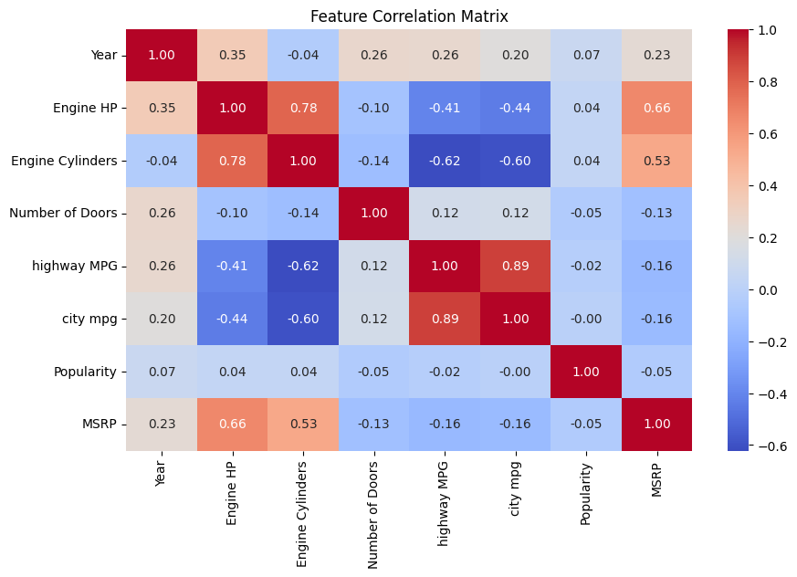
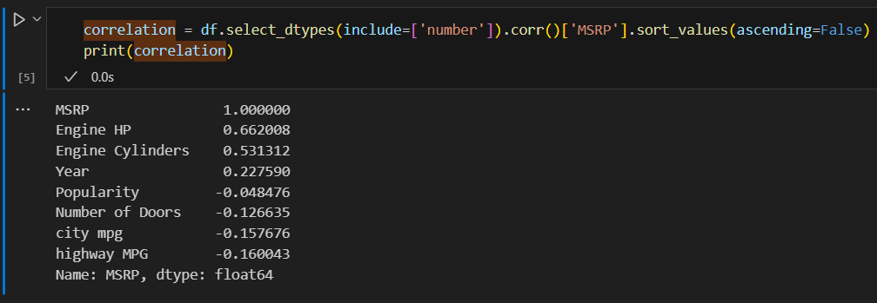
Feature Correlation with Price
1
Influential Features
2
Profitability
3
Brand Comparison
Engine HP significantly correlates with price.
Fuel efficiency boosts profitability.
Profit margins vary across different car brands.

Slide 4
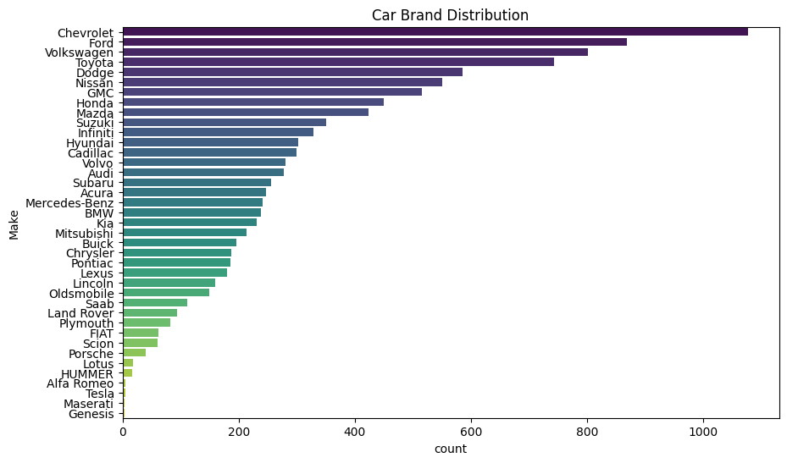


Profit Margins: Luxury vs. Economy
Luxury Cars
Economy Cars
High price elasticity is observed.
Value-driven pricing is crucial for success.

Slide 5

The Role of Fuel Efficiency
Fuel Efficiency
1
A key factor influencing car pricing.
2
Eco-Friendly
Consumers prefer eco-friendly options.
Future
3
Government policies promote fuel efficiency.

Slide 6
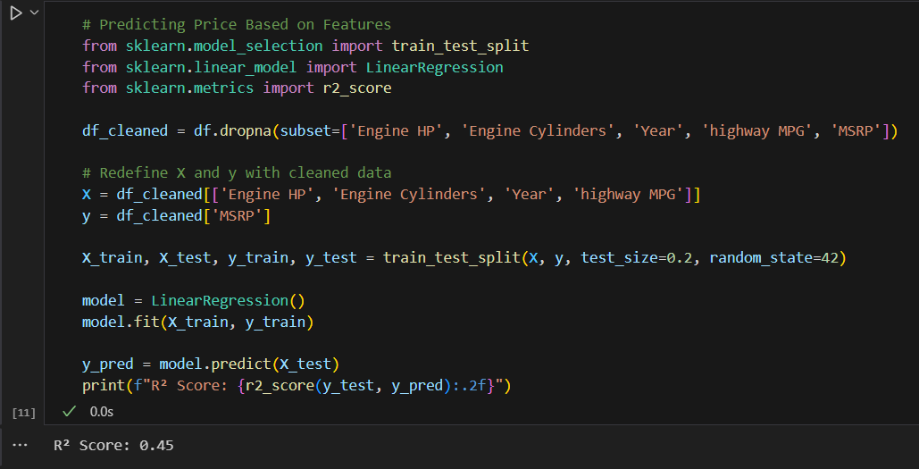



Regression Analysis for Price Prediction
Model Building
Regression models predict car prices accurately.
Insight
Model insights drive pricing strategies.
Strategy
Optimize prices with data-driven insights.

Slide 7



Strategies for Optimizing Pricing
Pricing
2
Optimize price based on features.
Segment
1
Identify high-margin car segments.
Manufacturing
Improve manufacturing for high margins.
3

Slide 8
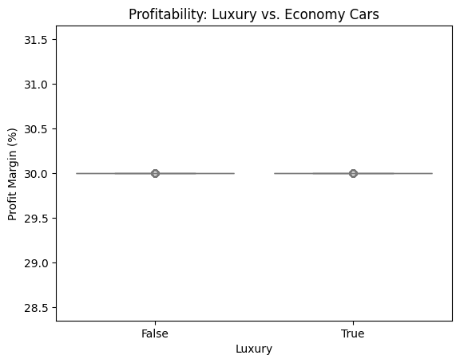
Identifying High-Margin Segments

Slide 9
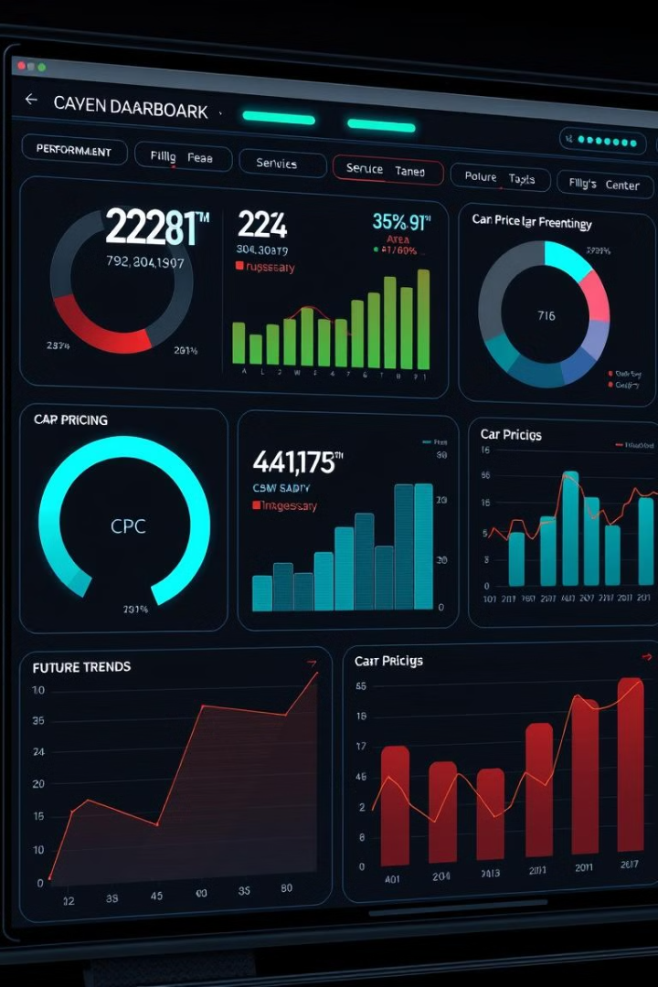
Key Insights and Next Steps
Key Insights
Data-driven pricing is essential. Optimize features for better profits.
Next Steps
Conduct deeper market research. Implement pricing strategies.

Slide 10
EDA and Regression Model
IPYNB File
eda.ipynb

